Slide 1
A/B TESTING
Yuanyuan Tong, Saral Joshi
Assignment 7

Slide 2
CONTENTS
Business Problem
Testing – Coupon Source
Testing – Shop For
Testing – Interaction

Slide 3
1
Business Problem
A major grocery chain wants to find out whether coupon usage increases the amount customers pay, and how this amount changes with other factors such as source of the coupon, or who does the consumer shop for.

Slide 4
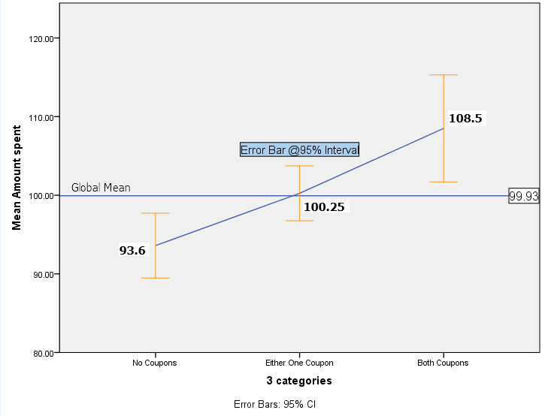
2
Coupon Use – One Way ANOVA
Recoded Coupon use to three categories H0 : No difference in mean amount spent by customers classified on basis of coupon use. Classification See diagram to the right, it shows us mean of each category, with global mean amount as a reference line, and a standard error of each category. The standard error for each category overlaps, (except 1&3) which tells us that we cannot say the means are different without ANOVA Result Null hypothesis rejected, based on ANOVA results (on the right), F (2) = 7.768 p-value<0.05 ANOVA shows us that there is a difference amongst mean values of the three groups, but by how much and between which all groups is not known.
Fig. Marginal Mean Plot, with error margin & Baseline
ANOVA
Amount spent
 | Sum of Squares | df | Mean Square | F | Sig.
Between Groups | 36261.668 | 2 | 18130.834 | 7.768 | .000
Within Groups | 3269983.695 | 1401 | 2334.035
Total | 3306245.363 | 1403
Fig. ANOVA results

Slide 5
3
Continued.. Coupon Use – One Way ANOVA
To specify exactly which groups differ from each other we look at Post Hoc tests, which compares the means of all three groups. The Leven statistic shows us that the variance across categories is not homogenous, hence we will use the Games-Howell post statistic test Fig. Levene’s test for homogeneity G-H test reveals that there is significant difference between amount paid when using a coupon, and not using a coupon
Test of Homogeneity of Variances
Amount spent
Levene Statistic | df1 | df2 | Sig.
5.372 | 2 | 1401 | .005
 | (I) 3 categories | (J) 3 categories | Mean Difference (I-J) | Std. Error | Sig.
No Coupons | Either One Coupon | -6.65 | 2.75 | 0.04 | 0.04
 | Both Coupons | -14.90 | 4.04 | 0.00 | 0.00
Either One Coupon | No Coupons | 6.65 | 2.75 | 0.04 | 0.04
 | Both Coupons | -8.25 | 3.89 | 0.09 | 0.09
Both Coupons | No Coupons | 14.90 | 4.04 | 0.00 | 0.00
 | Either One Coupon | 8.25 | 3.89 | 0.09 | 0.09
It is certainly better to provide coupons since they increase sales amount.
Even if a customer uses only one type of coupon, they will still pay more in the store than not using a coupon at all
There’s no significant difference in amount of sales between customers who use one type of coupon vs customers who use both type of coupons.
Fig. Games – Howel Post Hoc test

Slide 6
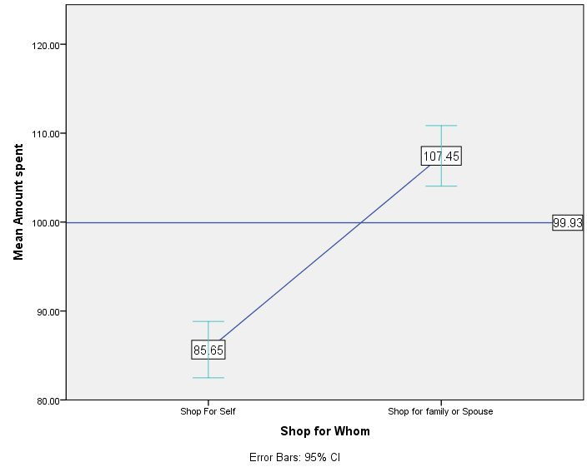
4
Shopping For – One Way ANOVA
Similar analysis can be performed for another variable, ShopFor, which splits customer base according who they shopped for, themselves or family/friends. H0: Mean Amount doesn’t differ across shopfor categories. Classification As requested, the model is based on 2 categories, as shown to the right. There is a distinction between people who buy for someone else, vs people who buy for themselves. ANOVA will show whether the difference is statistically good. Null hypothesis is rejected, the means are different across categories F (1) = 66.912 p-value<0.05 *Again, this tells us that, the two categories have different results, there is no to do post hoc analysis, since it is understood that the two existing categories are distinct.
Fig. Marginal means
ANOVA
Amount spent
 | Sum of Squares | df | Mean Square | F | Sig.
Between Groups | 150605.676 | 1 | 150605.676 | 66.912 | .000
Within Groups | 3155639.687 | 1402 | 2250.813
Total | 3306245.363 | 1403
Fig. ANOVA results

Slide 7
5
Shopping and Coupon Use – Univariate Analysis
Keeping amount as the dependent variable, we can use univariate analysis (GLM) to obtain what kind of interaction effects between shopfor and couponuse influence amount variable.
Levene's Test of Equality of Error Variancesª
Dependent Variable:
F | df1 | df2 | Sig.
14.579 | 5 | 1398 | 0.000
Assumption of homo-variance failed
We ran our model using above variables and obtained the following results:
Interaction effect is significant since sig < 0.05
Main effects are account for more variance explained that the interaction effect.
Interaction effect accounts for very less variance explained.
The model has a low overall F statistic.
Dependent Variable:
Source | Type III Sum of Squares | df | Mean Square | F | Sig. | Partial Eta Squared
Corrected Model | 195724.151ª | 5 | 39144.830 | 17.593 | 0.000 | 0.059
Intercept | 9664192.793 | 1 | 9664192.793 | 4343.498 | 0.000 | 0.757
usecouprecode | 37906.134 | 2 | 18953.067 | 8.518 | 0.000 | 0.012
shopforrecode | 128040.879 | 1 | 128040.879 | 57.547 | 0.000 | 0.040
usecouprecode * shopforrecode | 14674.629 | 2 | 7337.314 | 3.298 | 0.037 | 0.005
Error | 3110521.212 | 1398 | 2224.979
Total | 17327659.518 | 1404
Corrected Total | 3306245.363 | 1403
a. R Squared = .059 (Adjusted R Squared = .056)

Slide 8
5
Cont… Shopping and Coupon Use – Univariate Analysis
Contrast Results (K Matrix)
3 categories Simple Contrastª |  |  | Dependent Variable
 |  |  | Amount spent
Level 2 vs. Level 1 | Contrast Estimate |  | 9.370
 | Hypothesized Value |  | 0
 | Difference (Estimate - Hypothesized) |  | 9.370
 | Std. Error |  | 3.060
 | Sig. |  | 0.002
 | 95% Confidence Interval for Difference | Lower Bound | 3.366
 |  | Upper Bound | 15.373
Level 3 vs. Level 1 | Contrast Estimate |  | 15.787
 | Hypothesized Value |  | 0
 | Difference (Estimate - Hypothesized) |  | 15.787
 | Std. Error |  | 4.030
 | Sig. |  | 0.000
 | 95% Confidence Interval for Difference | Lower Bound | 7.883
 |  | Upper Bound | 23.692
Both these tests reveal that the main influence have statistically significant influence on amount (p-value<0.05). The “Contrast estimate” metric tells us the size of the difference of the mean with “first” category as reference.
Contrast results for Coupon Use variable
Recoded Simple Contrastª |  |  | Dependent Variable
 |  |  | Amount spent
Level 2 vs. Level 1 | Contrast Estimate |  | 22.345
 | Hypothesized Value |  | 0
 | Difference (Estimate - Hypothesized) |  | 22.345
 | Std. Error |  | 2.946
 | Sig. |  | 0.000
 | 95% Confidence Interval for Difference | Lower Bound | 16.567
 |  | Upper Bound | 28.123
Contrast results for Shopfor variable

Slide 9
6
Gender and Coupon Use – Univariate Analysis
Note: We don’t require analysis of covariance because there are no continuous predictors, all predictors are categorical, if there was a continuous predictor we could have used ANCOVA

